Slide 1
Task 2. Predicting Customer Buying Behavior at British Airways
Objective: Utilize machine learning to predict customer buying behaviors, enhancing strategic decisions and marketing approaches.
Data & Preprocessing: Analysis of customer_booking.csv with 50,000 entries. Preprocessing involved encoding correction, data type conversion, and ensuring no null values across 14 features.
Key Features: Includes number of passengers, sales channel, trip type, route, booking origin, and customer preferences (e.g., extra baggage, preferred seat).
Adilet Mussabekov
2024

Slide 2
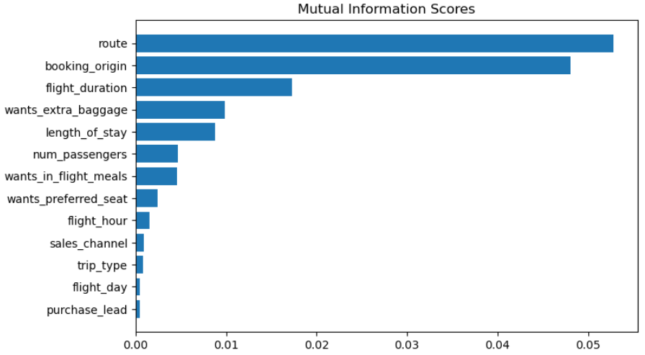
Model Selection, Performance, and Strategic Insights
Model Exploration: Evaluated Random Forest and XGB Classifier models across different feature sets. Mutual Information (MI) scores highlighted route, booking_origin, and flight_duration as top predictors.
Best Performing Model: Random Forest Classifier with all features, demonstrating an accuracy of 84.76% and AUC score of 0.5479604084813514 on validation data. Final validation on test data showed an accuracy of 85.09% and AUC score of 0.5577796717361984.
Recommendations:
Strategic Marketing: Leverage insights to tailor marketing efforts, focusing on the most predictive factors of booking completion.
Customer Experience: Use predictions to improve targeted offerings, enhancing customer satisfaction and loyalty.

